Slide 1

ROLE OF BINARY NUMBERS IN COMPUTER SCIENCE
PRESENTATION
Presented by Team
Code & Cry

Slide 2
COURSE & FACULTY DETAILS
Presentation topic : Role of binary number in Computer Science
Course title : Digital Logic Design
Course code : CSE223
Faculty Details
Shah Md Tanvir Siddique
Assistant Professor
Department of CSE
Daffodil International University

Slide 3
TEAM MEMBERS & CONTENTS
Name : MD. Hasib Hossain
ID : 0242310005101195
Topic : Introduction
Name : Tasmia Tarannum Silme
ID : 0242310005101090
Topic : Role of Binary Number
Name : S.M. Sadman Al Siam
ID : 0242310005101123
Topic : Data Representation
Name : MD. Sazzadul Islam Shaon
ID : 0242310005101028
Topic : Image & Video Representation
Name : Meheruba Binte Kashem Anti
ID : 0242310005101157
Topic : Network Communication

Slide 4
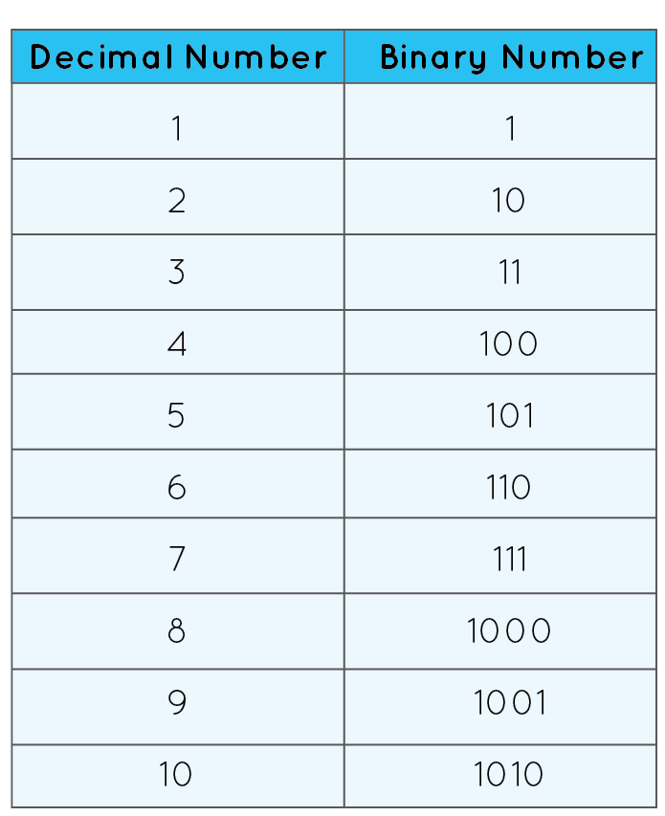
WHAT IS BINARY NUMBER SYSTEM?
Binary Number System : A positional system using only two digits: 0 and 1.
Base-2 System : Unlike decimal (base-10), binary is base-2.
Relevence : Computers operate on binary due to their digital nature.

Slide 5

ROLE OF BINARY NUMBER IN COMPUTER SCIENCE
Electrical circuits
Data representation
Image & Video representation
Sound & Audio representation
Network communication
Encryption & Security

Slide 6
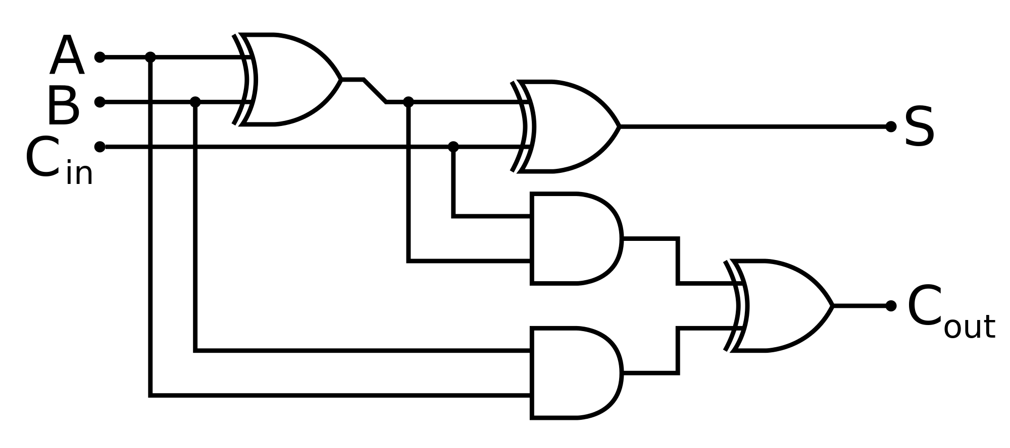
WHY BINARY IN COMPUTERS?
Electrical Circuits : Computers use binary because circuits have two voltage levels (on/off).
It makes the system,
1. Simple
2. Efficient
3. Reliable
4. Less error
5. Faster processing

Slide 7
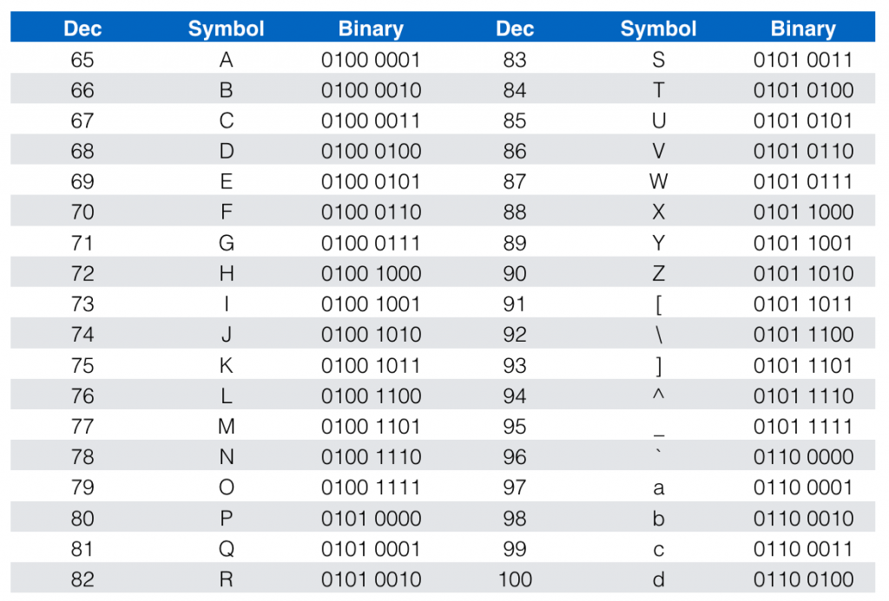
BINARY IN DATA REPRESENTAION
Text Representation : Binary codes like ASCII and Unicode represent characters.
Example: In ASCII, 'A' is 01000001 in binary.

Slide 8
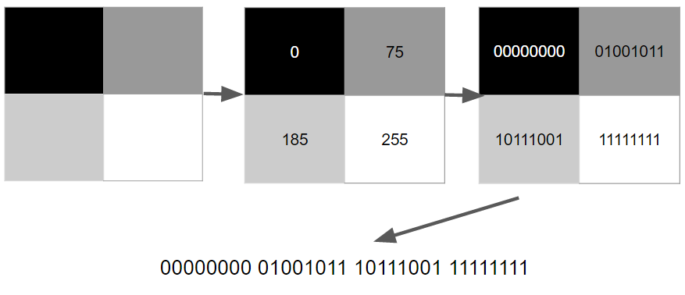
BINARY IN IMAGE & VIDEO DATA
Pixel : Binary represents pixels in grayscale or color images.
Digital Video : Binary-encoded frames make up digital videos.

Slide 9
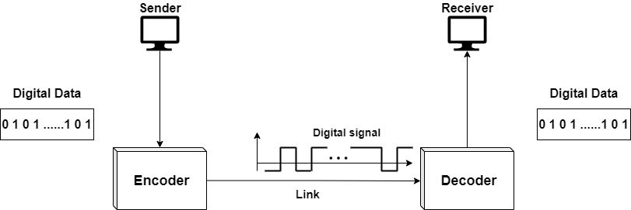
BINARY IN NETWORK COMMUNICATION
IP Addresses: IPv4 and IPv6 addresses are binary numbers.
Data Transmission: Binary packets transmit data across networks.

Slide 10
THANK YOU

Slide 11
ANY QUESTIONS?

